Slide 1
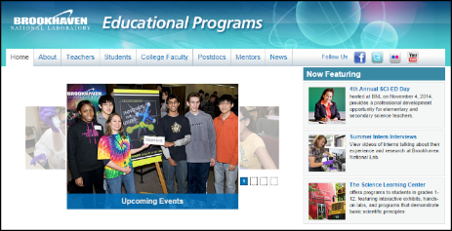
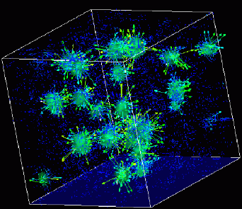
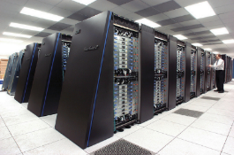
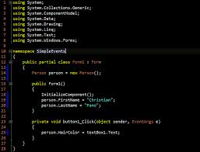
Advanced
Scientific Computing
(SciComp 201)
Session 13 - Computational Mathematics

Slide 2
Session Goals
Represent a quadratic polynomial in computer code
Use nested for() loops to factor the coefficients
Gain an appreciation for Strassen’s method
Calculate the following statistics on a set of random numbers
Mean, Median, & Mode
Variance, Standard Deviation

Slide 3
Representing a Quadratic Polynomial
The Fundamental Theorem of Algebra shows a polynomial of degree 2 will have exactly 2 roots
The roots can be unique or repeated
Either one (or both) of the roots can be a real or complex number
Assume we have a factored quadratic polynomial
$$\left(ax+b\right)\left(cx+d\right)=0$$
$$\left(ac\right)x^{2}+\left(ad+bc\right)x+\left(bd\right)=0$$
$$Jx^{2}+Kx+L=0$$
$$J=(ac), K=\left(ad+bc\right), L=(bd)$$

Slide 4
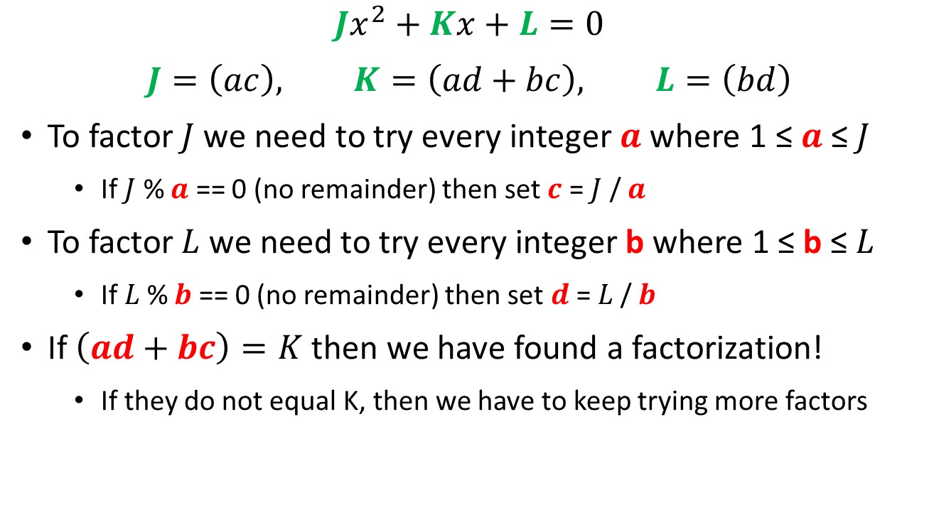
Factoring a Quadratic Polynomial
$$Jx^{2}+Kx+L=0$$
$$J=\left(ac\right), K=\left(ad+bc\right), L=\left(bd\right)$$
To factor $J$ we need to try every integer $a$ where 1 ≤ $a$ ≤ $J$
If $J$ % $a$ == 0 (no remainder) then set $c$ = $J$ / $a$
To factor$L$ we need to try every integer b where 1 ≤ b ≤$L$
If$L$% $b$ == 0 (no remainder) then set $d$ =$L$/ $b$
If $\left(ad+bc\right)=K$ then we have found a factorization!
If they do not equal K, then we have to keep trying more factors

Slide 5
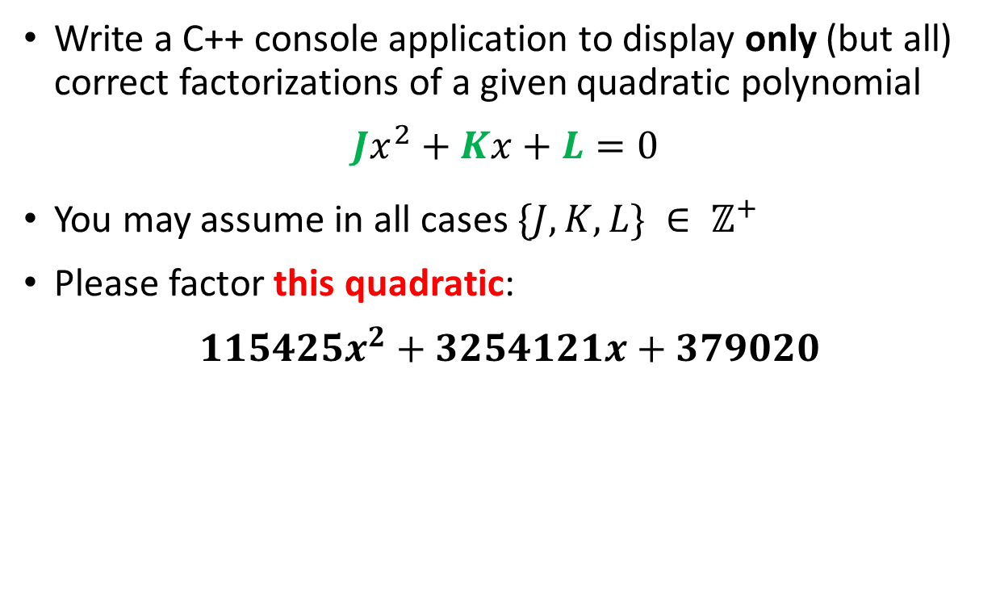
Lab 1 – Factor Quadratic Polynomial
Write a C++ console application to display only (but all) correct factorizations of a given quadratic polynomial
$$Jx^{2}+Kx+L=0$$
You may assume in all cases $\{J, K, L\} ∈ ℤ^{+}$
Please factor this quadratic:
$115425x^{2}+3254121x+379020$

Slide 6
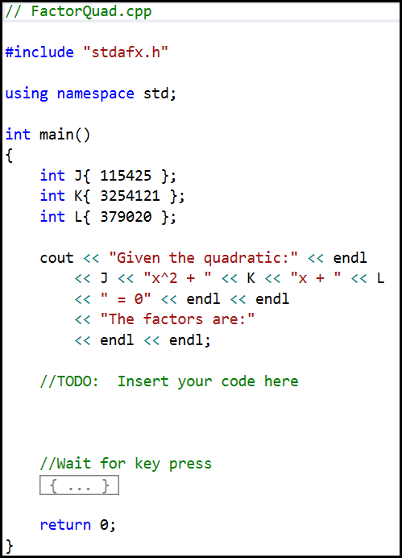
Lab 1 – Factor Quadratic Polynomial

Slide 7
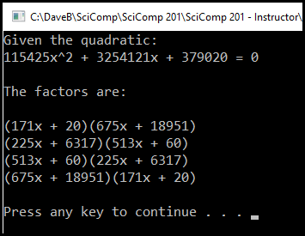

Lab 1 – Factor Quadratic Polynomial
$115425x^{2}+3254121x+379020$
The code is not smart enough to recognize the commutative and distributive properties of multiplication, so it lists several legal but redundant roots

Slide 8
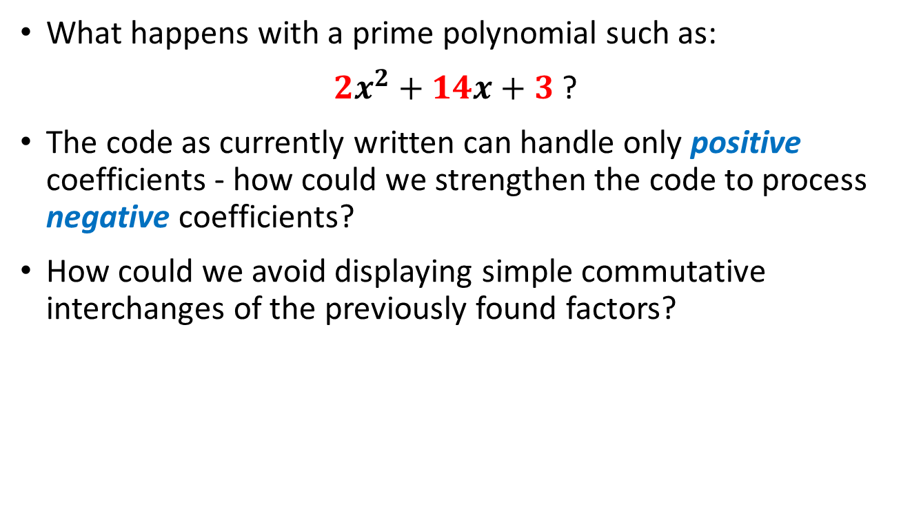
Lab 1 – Factor Quadratic Polynomial
What happens with a prime polynomial such as:
$2x^{2}+14x+3$ ?
The code as currently written can handle only positive coefficients - how could we strengthen the code to process negative coefficients?
How could we avoid displaying simple commutative interchanges of the previously found factors?

Slide 9
Strassen’s Method
Multiplication is repeated addition, so a computer is much faster at adding two numbers than multiplying them
From our first days in Algebra we are taught that you can only add “like” terms (those terms where each variable and exponent are the same)
Hence we are taught that the FOIL method of expanding the product of two monomials requires four (4) multiplications: first, outside, inside, last:
$$\left(ax+b\right)\left(cx+d\right)=\left(ac\right)x^{2}+\left(ad+bc\right)x+(bd)$$

Slide 10
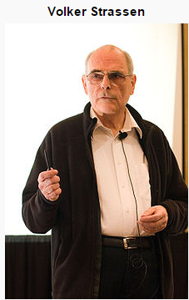
Strassen’s Method
Volker Strassen showed in 1969 that you
only need three (3) multiplications
$$\left(3x+5\right)\left(7x+9\right)$$
$$3 ∗7=21$$
$$5 ∗9=45$$
$$8 ∗16=128$$
The solution is then:
$$\left(21\right)x^{2}+\left(128 −45 −21\right)x+\left(45\right)$$
$$21x^{2}+62x+45$$

Slide 11
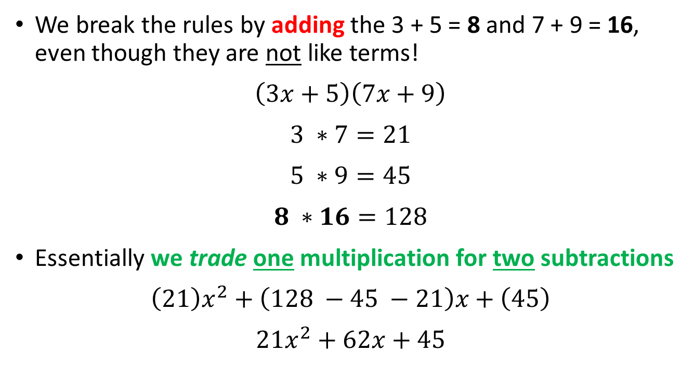
Strassen’s Method
We break the rules by adding the 3 + 5 = 8 and 7 + 9 = 16, even though they are not like terms!
$$\left(3x+5\right)\left(7x+9\right)$$
$$3 ∗7=21$$
$$5 ∗9=45$$
$$8 ∗16=128$$
Essentially we trade one multiplication for two subtractions
$$\left(21\right)x^{2}+\left(128 −45 −21\right)x+\left(45\right)$$
$$21x^{2}+62x+45$$

Slide 12
Strassen’s Method
When we cover matrix multiplication, you will find that the naïve approach requires N³ operations, so a 3 x 3 matrix multiply requires 27 multiplications
Volker Strassen showed in his 1969 paper that the exponent is less than 3. In fact further improvements on Strassen’s method has brought this down to N^{2.375477}
Why is this important? Because if you have really large matrices (think about solving 1,000 equations with 1,000 unknowns) the difference adds up quickly
With N = 1000, Strassen’s method is 74x faster! than the naïve approach to matrix multiplications

Slide 13
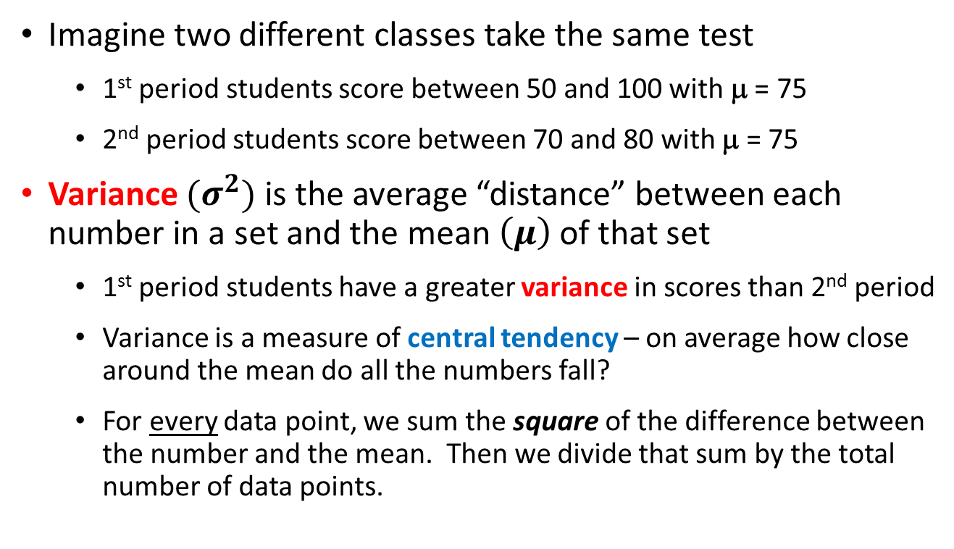
Mean vs. Variance
Imagine two different classes take the same test
1st period students score between 50 and 100 with μ = 75
2nd period students score between 70 and 80 with μ = 75
Variance ${(σ}^{2})$ is the average “distance” between each number in a set and the mean $\left(μ\right)$ of that set
1st period students have a greater variance in scores than 2nd period
Variance is a measure of central tendency – on average how close around the mean do all the numbers fall?
For every data point, we sum the square of the difference between the number and the mean. Then we divide that sum by the total number of data points.

Slide 14
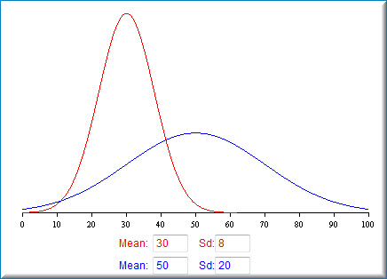
Mean vs. Standard Deviation
Note: Standard Deviation (σ) is the square root of the Variance (σ²)

Slide 15
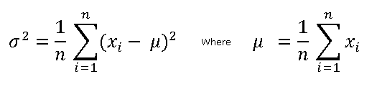

Mean, Variance, Standard Deviation
Variance
Mean
Standard Deviation

Slide 16
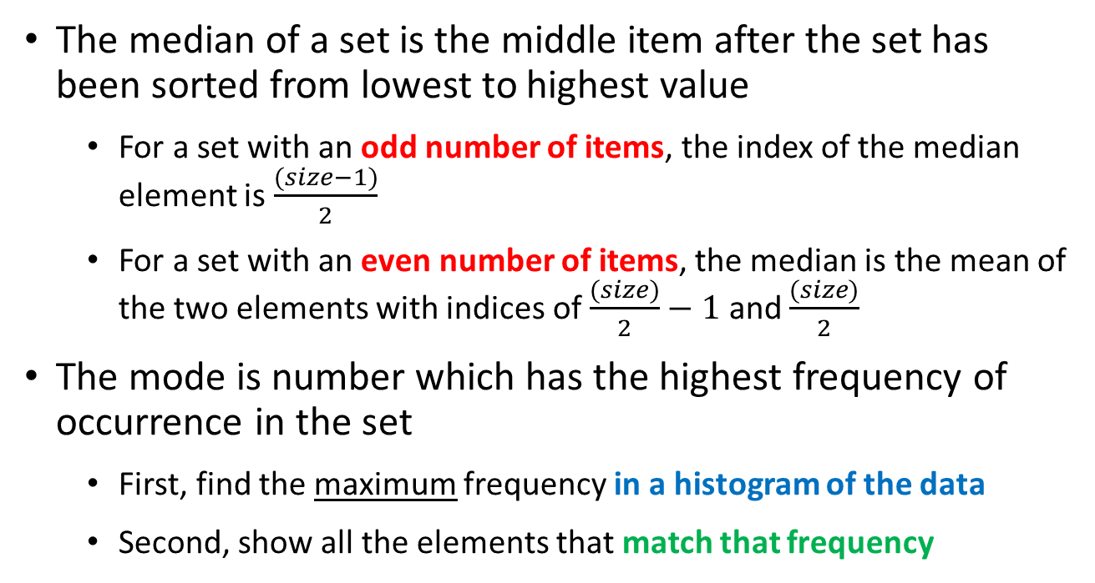
Median & Mode
The median of a set is the middle item after the set has been sorted from lowest to highest value
For a set with an odd number of items, the index of the median element is $\frac{(size−1)}{2}$
For a set with an even number of items, the median is the mean of the two elements with indices of $\frac{(size)}{2}−1$ and $\frac{(size)}{2}$
The mode is number which has the highest frequency of occurrence in the set
First, find the maximum frequency in a histogram of the data
Second, show all the elements that match that frequency

Slide 17
Lab 2 – Statistics Package
Write a C++ console app to calculate and display the following statistics for a set of 10,000 integers ranging from 0 to 100 (inclusive)
Sample Size
Mean
Variance
Standard Deviation
Median
Mode(s) – there could be more than one mode!

Slide 18
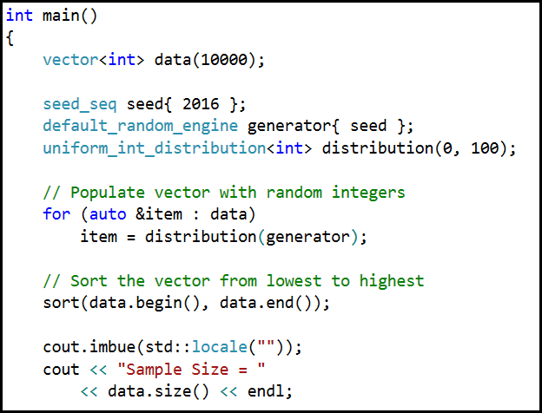
Lab 2 – Statistics Package

Slide 19
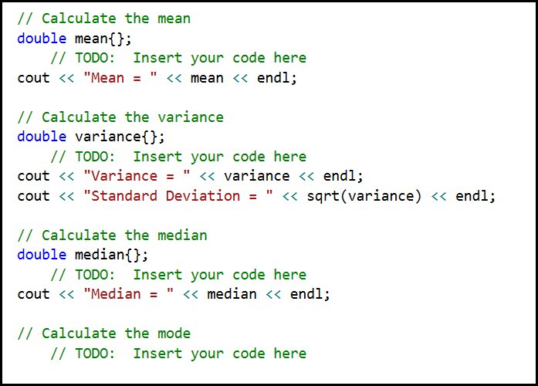
Lab 2 – Statistics Package

Slide 20
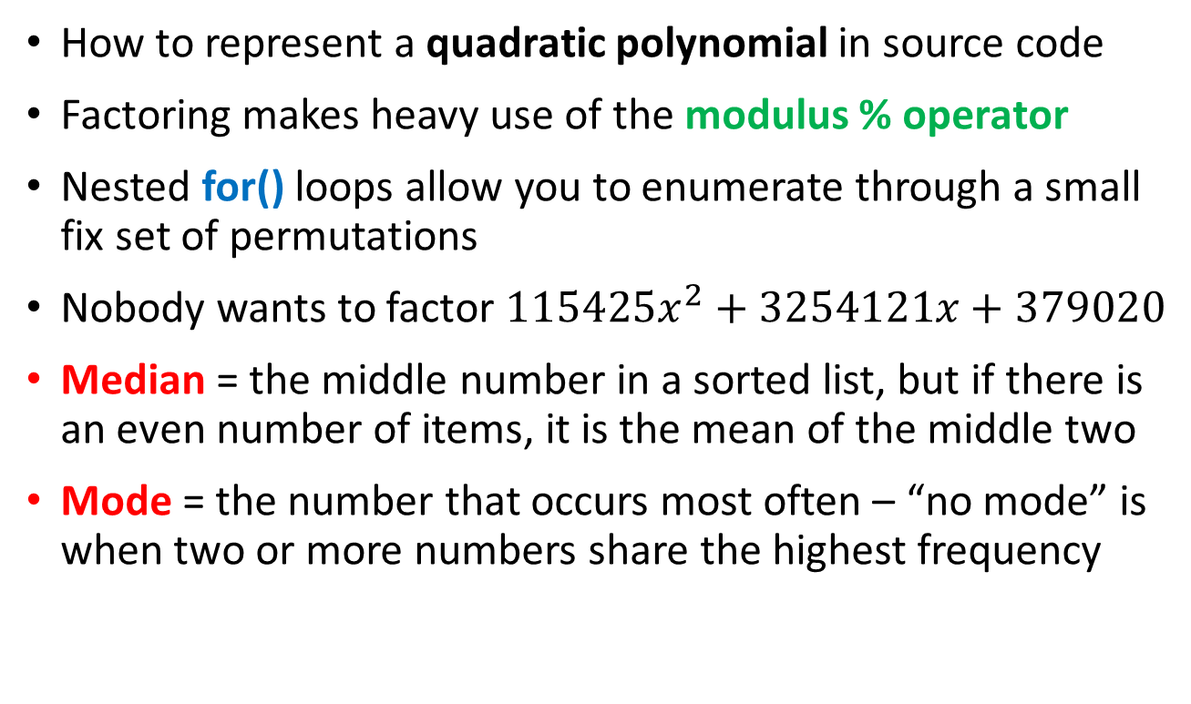
Now you know…
How to represent a quadratic polynomial in source code
Factoring makes heavy use of the modulus % operator
Nested for() loops allow you to enumerate through a small fix set of permutations
Nobody wants to factor $115425x^{2}+3254121x+379020$
Median = the middle number in a sorted list, but if there is an even number of items, it is the mean of the middle two
Mode = the number that occurs most often – “no mode” is when two or more numbers share the highest frequency

